Slide 1
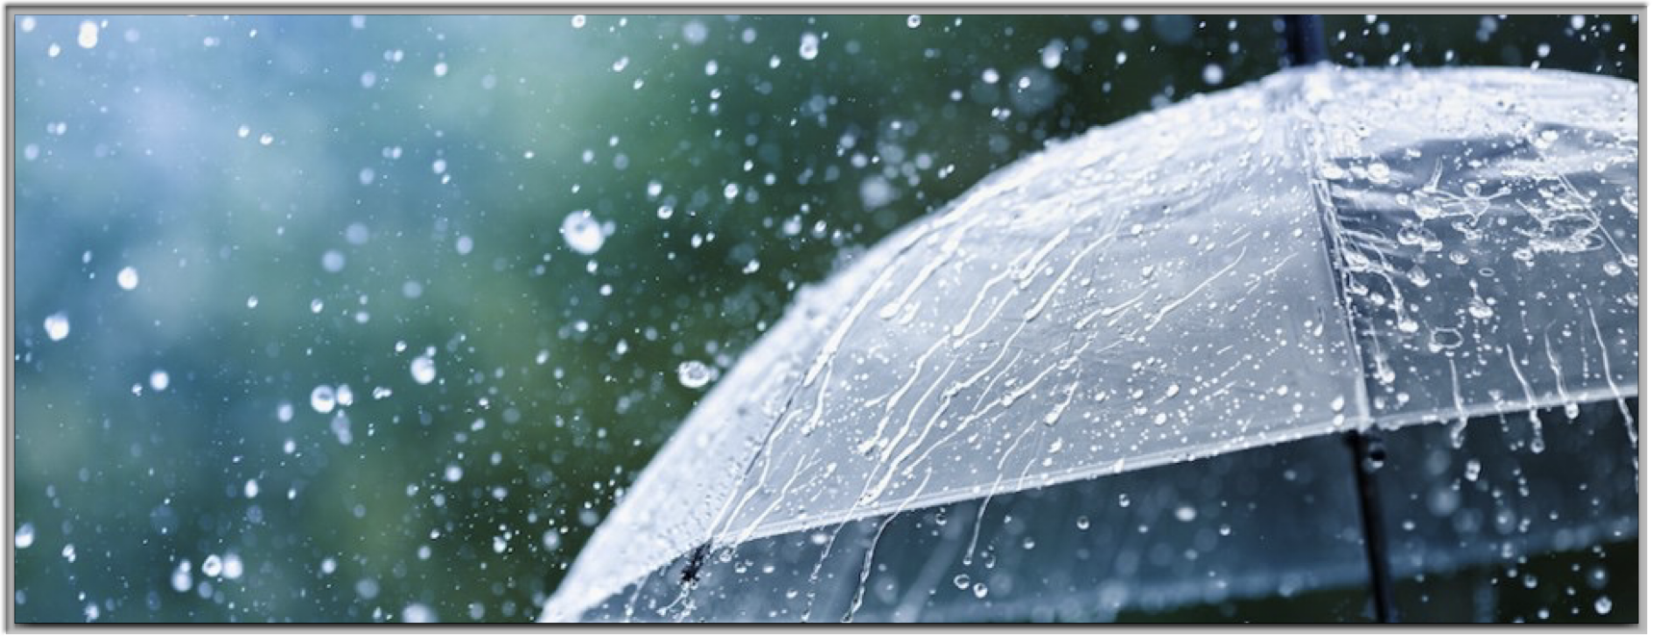
The Weather App
Midterm Project by:
Juan Camilo Cifuentes
Alejandro Guerra Villegas

Slide 2
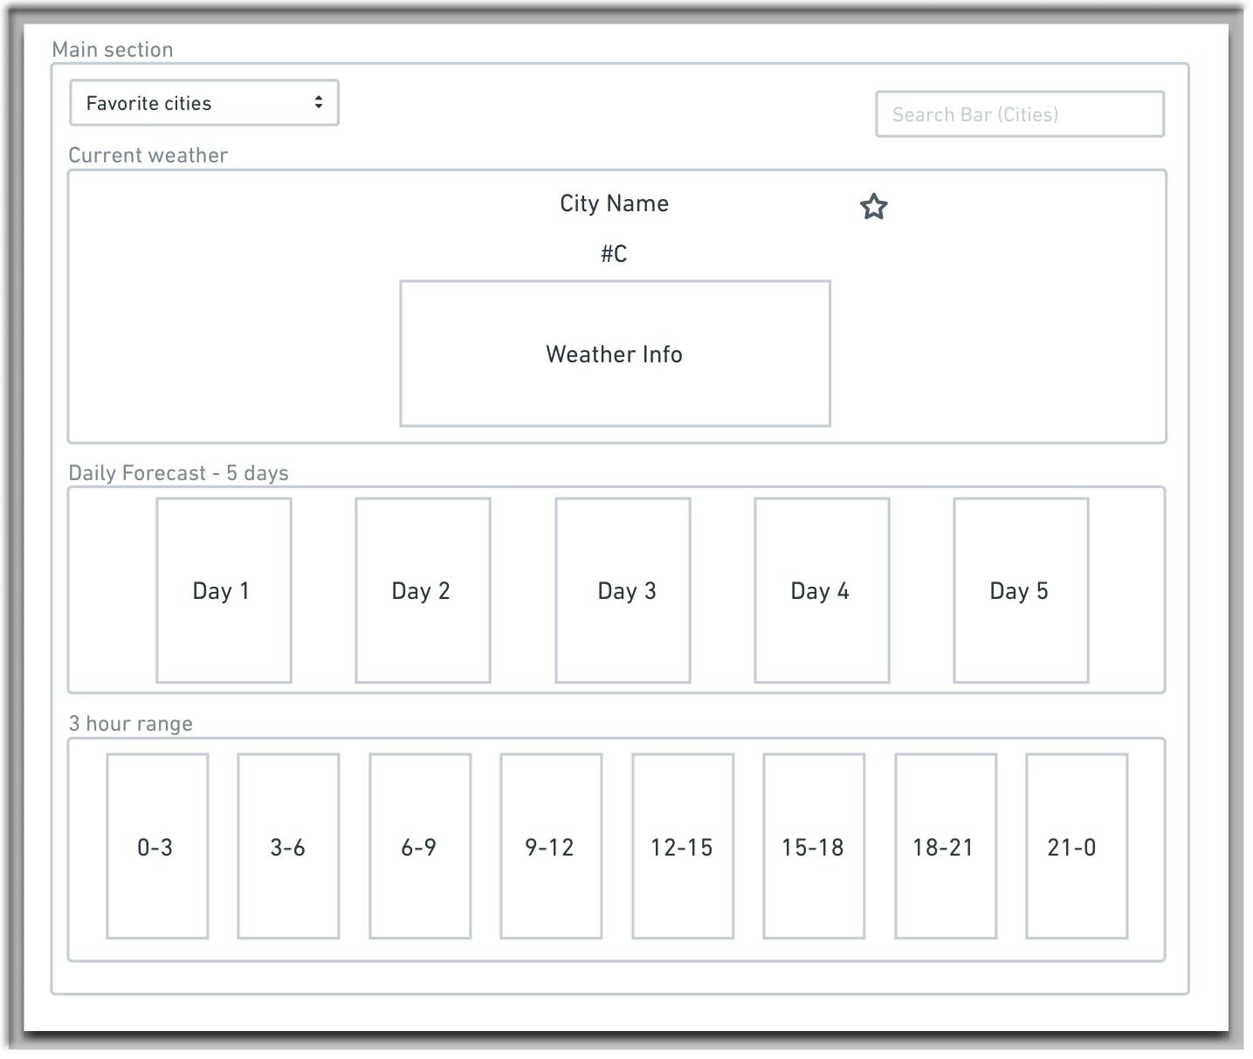


Wire Frame & Goals
Vancouver as Main City
Display basic weather info
Display 5 days & 3 hrs forecast
Have an Autocomplete Search bar
Be able to save Favorites

Slide 3
Work Flow
Juan Camilo Cifuentes:
Favorite Cities
5 days forecast
3 hours forecast
Alejandro Guerra Villegas:
Current City Weather
Search Bar & Autocomplete

Slide 4
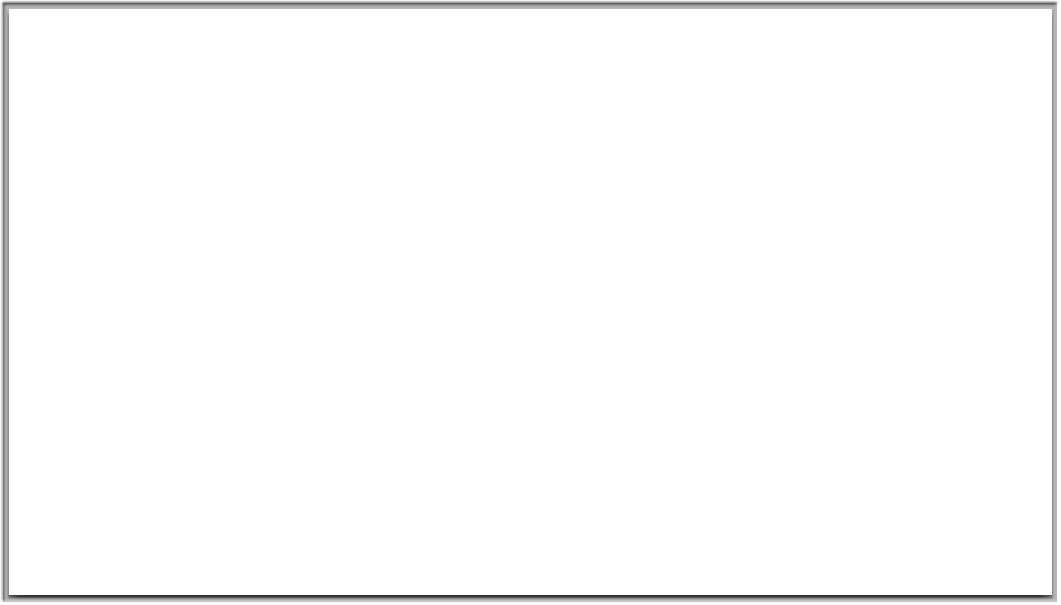
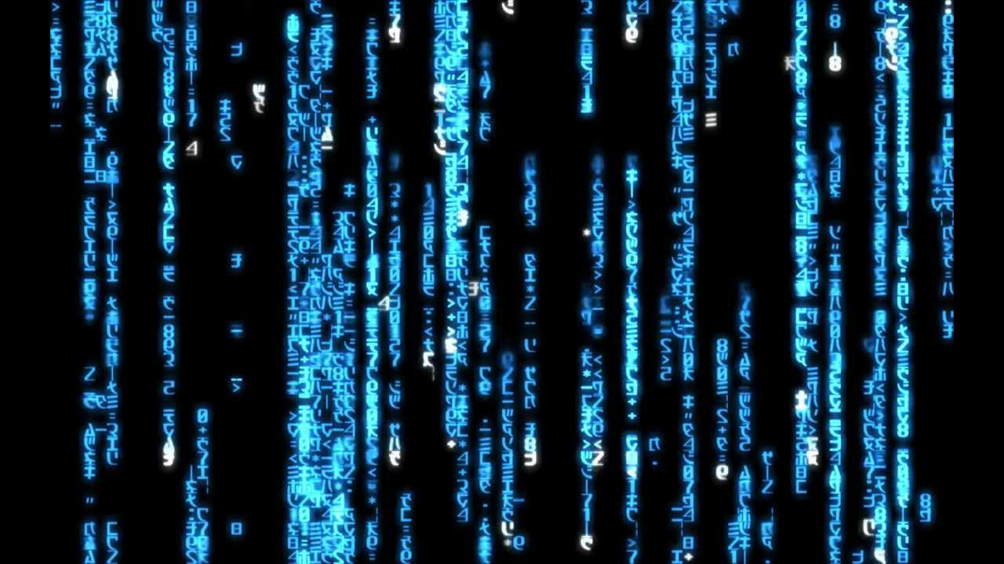
Let’s explain our Code

